Slide 1
Item/doc 7.1 – Priority activities and action plan for EW4All
Third Session of the Infrastructure Commission
(INFCOM-3, 15-19 April 2024)
Michel Jean/president
15 April 2024

Slide 2
Content
Background
Decisions of Congress and the Executive Council
Rapid Assessment by the Secretariat
Coordination through the Technical Coordination Committee
Action plan of the Infrastructure Commission
draft Decision 7.1/1 – List of INFCOM priority activities contributing to the Early Warnings for All initiative
draft Recommendation 7.1/1 – Action Plan for INFCOM contributions to the Early Warnings for All initiative

Slide 3
Decisions of Congress and the Executive Council
Resolution 4 (Cg-19), Congress requested the technical commissions to identify high priority activities to address the urgent needs of Members in building effective MHEWSs falling within their terms of reference (ToR) and to incorporate them into their respective work plans for the next financial period
Resolution 1 (EC-77), requested the RAs, technical commissions and RB, under the guidance of EC, to consolidate all their relevant activities under the EW4All umbrella and report back to EC;
Resolution 7 (EC-77) - Subsidiary bodies of the Executive Council, delegated the role of coordinating the technical bodies of the Organization (technical commissions, the RB, and other relevant bodies) and the RAs to the Technical Coordination Committee (TCC).

Slide 4
Pillar 2 Rapid Assessment
Purpose: To inform the planning stage of EW4All through baseline data and analysis, and to identify the areas with the capacity gaps.
Developed by the Secretariat for appraising the monitoring and forecasting capacity of the 30 countries selected by the UN for coordinated assistance, based on interviews (self-reported data), structured along the seven elements of the hydromet value chain:
Legal framework and institutional mechanisms of the NHMS
Observation infrastructure
Hazard monitoring capacity
Use of remote-sensing data
Use of NWP models and forecasting tool application
Impact-based forecasting capacity
Warning services and early warning system operations
The Country Hydromet Diagnostics (CHD) were conducted in all 30 countries as part of the SOFF readiness phase, to validate the self-reported data through the peer advisors and the Secretariat Regional Offices and project managers.

Slide 5
Priority hazards – coordinated through TCC
Number of countries that identified the hazard as one of 5 priorities
Eventually, priority hazards covered by the EW service need to be decided by each country.
For the short-term actions, TCC identified Flood, Drought, TC, heatwave plus Thunderstorm/squall lines ad priority hazards.
This is largely based on the results of the Rapid Assessment conducted by the WMO Secretariat.

Slide 6
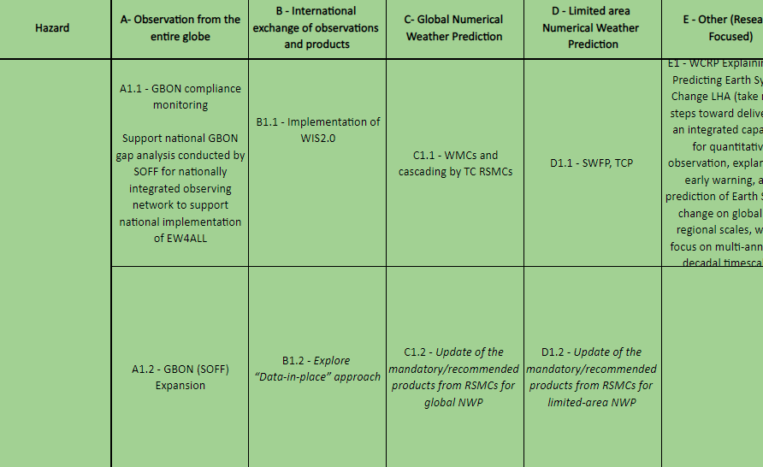
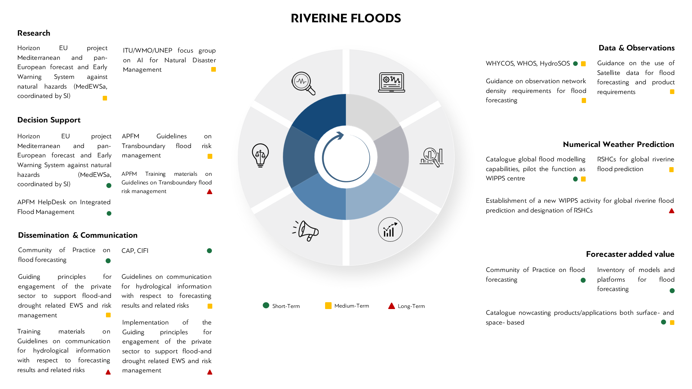
Consolidated list of priority activities – coordinated through TCC
Consolidated list of priority activities by INFCOM, SERCOM and RB produced; INFCOM priority activities are included.
A narrative version is presented as INFCOM-3/INF 7.1.
Reviewed by Members through Regional Associations.
Roadmap for WMO contribution to EW4All is being developed, submitted to EC-78 as an INF document, which is based on the consolidated list of priority activities (INFCOM-3 decision will be reflected).

Slide 7
Action plan of the Infrastructure Commission
Task Team on EW4All
to carry out a quick gap analysis in global frameworks for observation and prediction data provision and draft an action plan
Draft Recommendation 7.1/1 - Action Plan for INFCOM contributions to EW4All
Task Team on non-traditional sources
to assess available global products from traditional and non-traditional sources for riverine flood prediction, in terms of their quality and operational availability, and the possibility to include riverine flood prediction as a new WIPPS activity as a desktop study.
draft Recommendation 8.4(3)/1
Draft Decision 7.1/1 – Priority activities of INFCOM contributing to EW4All

Slide 8
Document 7.1 Draft Decision 7.1/1 to decide priority activities of INFCOM
Implement the WMO Information System (WIS) 2.0, including the development of a Common Alerting Protocol (CAP) editor to be part of the “WIS 2.0 in a box” and the development of the WMO Hydrological Observing System (WHOS) in the pre-operational phase of WIS 2.0;
Implement the Global Basic Observing Network (GBON), including through the (support provided by/via the) Systematic Observations Financing Facility (SOFF);
Guide and support the development of the Regional Basic Observing Network (RBON);
Analyse gaps and enhance WMO Integrated Processing and Prediction System (WIPPS) products for priority hazards, including:
Enhance the information and service cascading process of the Severe Weather Forecasting Programme (SWFP), the Climate Services Information System (CSIS), and the Tropical Cyclone Programme (TCP); and
Improve accessibility and usability of WIPPS products including graphical products;
Enhance engagement of academic and private-sector players in WIPPS development;
Enhance the introduction of new emerging technologies (e.g., Artificial Intelligence (AI)) and science into WIPPS;
Catalogue and analyse gaps of satellite products and applications for priority hazards;
Support Members to ensure access to satellite data and products and with train-the-trainers focused on access, processing, visualization, and interpretation of satellite data; and
Address the needs for cryosphere-related emerging hazards.

Slide 9
Document 7.1 Draft Recommendation 7.1/1 to propose the Action Plan
Action Plan for infrastructure components contributing to EW4All, consisting of work plans to:
consider EW4All observational user requirements and gaps through the Regional Basic Observing Network,
address the gaps in satellite data/products,
analyse gaps and enhance WMO Integrated Processing and Prediction System products for priority hazards, and
address cryosphere-related emerging hazards
These areas require coordinated actions by the RAs, technical commissions and the RB; the Action Plan is intended to be used as a supporting material for coordination among these bodies, by the Technical Coordination Committee.

Slide 10
Thank you.
^{wmo.int}

